Slide 1
The Intergovernmental Panel on Climate Change
Silvia Caldararu
Email: caldaras@tcd.ie

Slide 2

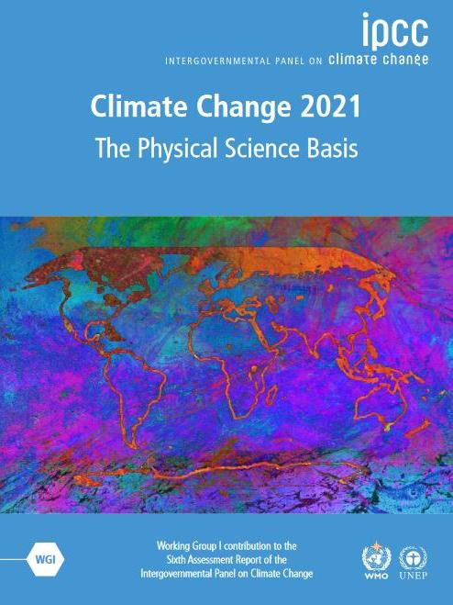
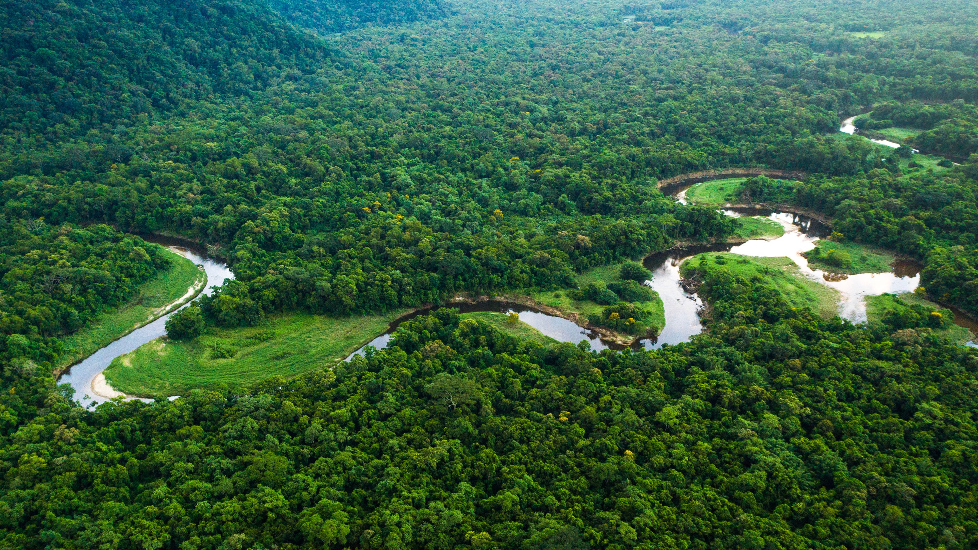

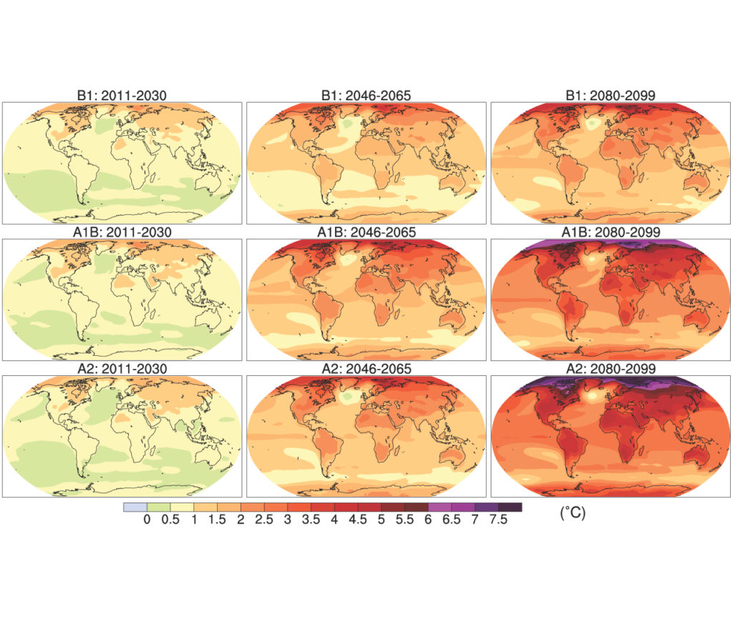
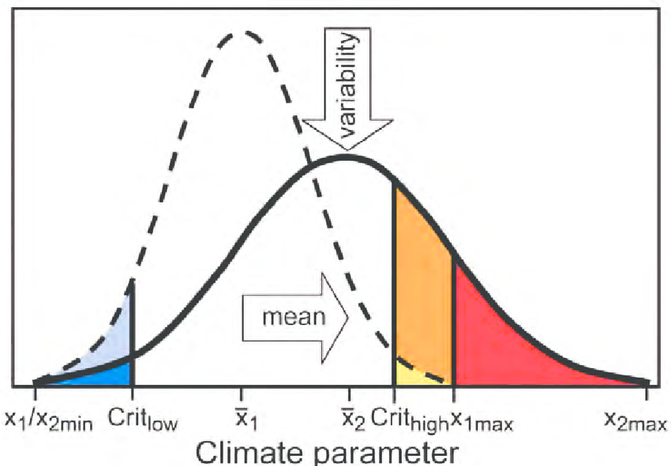
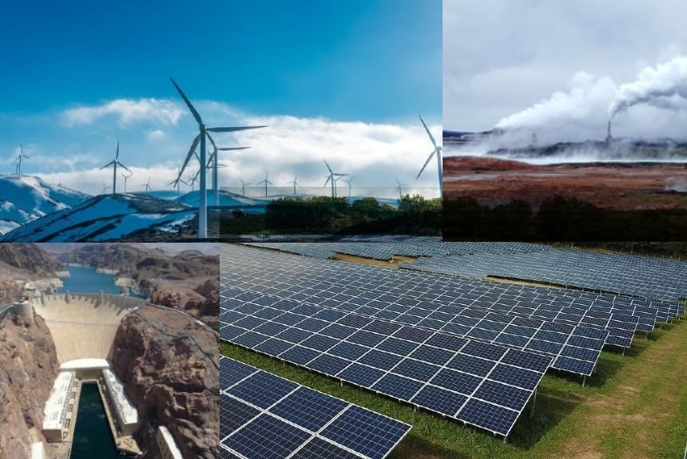
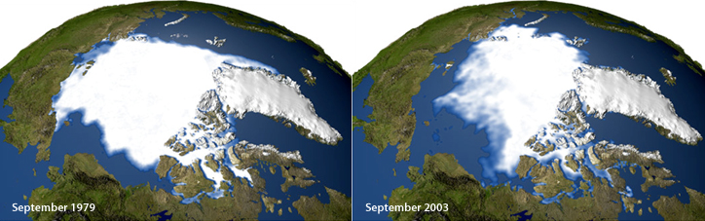
Atmosphere
Climate fundamentals
Predicting climate
Atmosphere
Global C cycle
IPCC report
Earth system models
Climate impacts
Climate solutions
Extreme events
Tipping points
Sea ice, ice caps,
Energy
Mitigation
Nature-based solutions

Slide 3
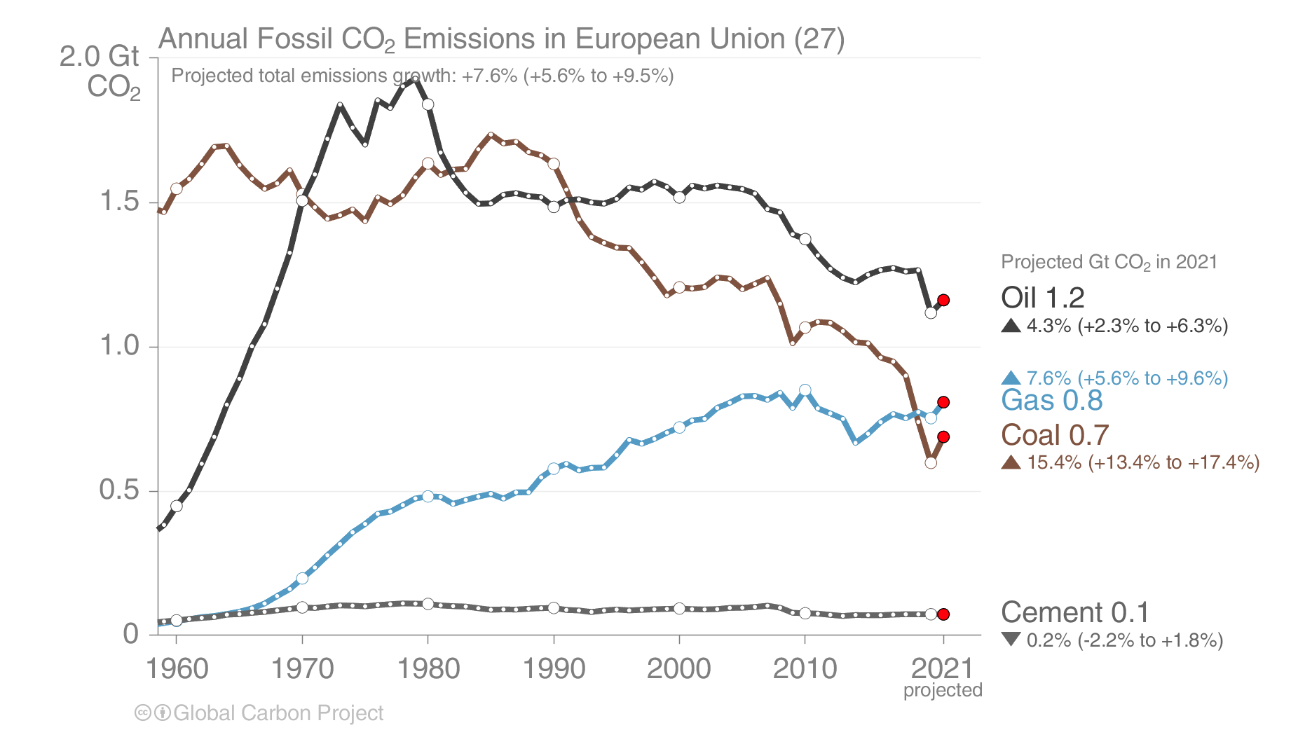
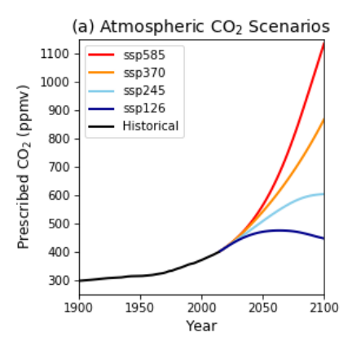
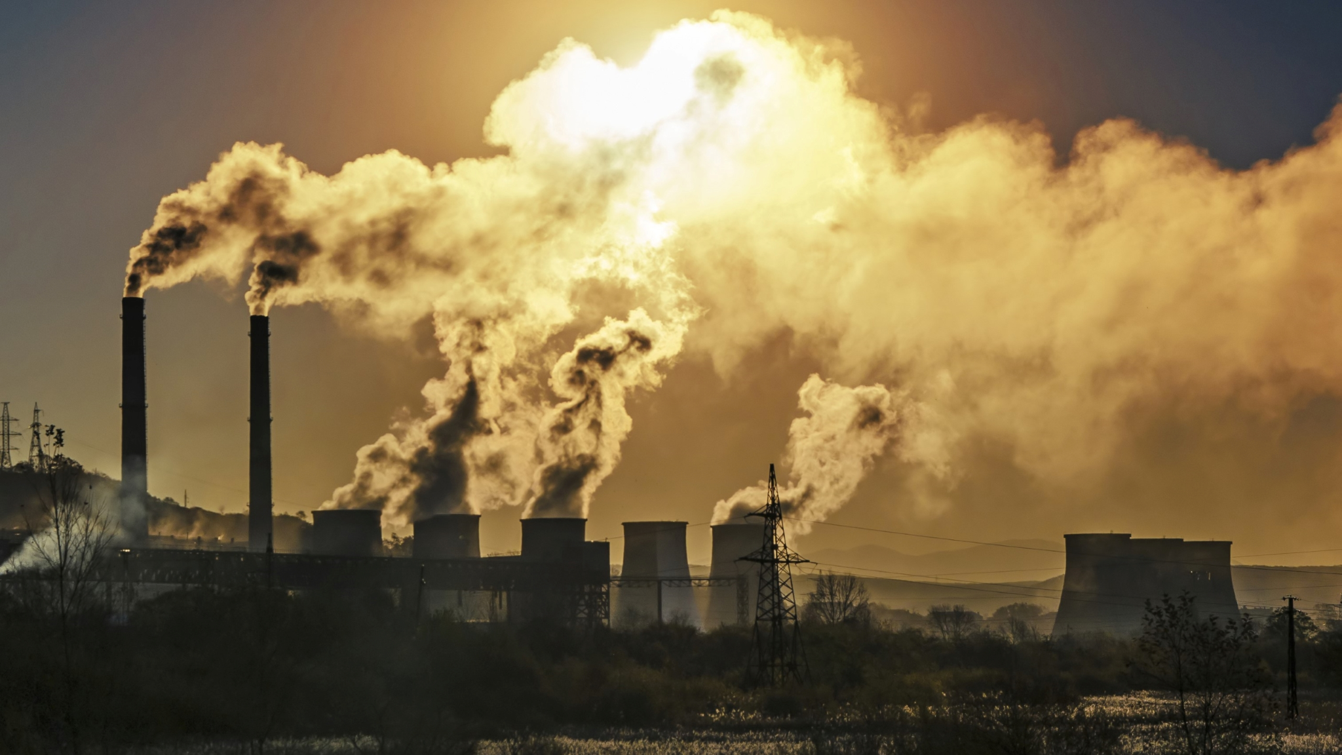
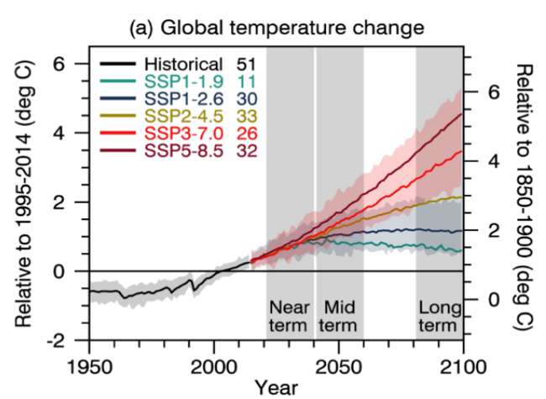
CO₂ emissions
How do we go from greenhouse gas emissions to prediction of future climate?
CO₂ concentrations
Changes in climate

Slide 4
Knowledge of how the Earth system works
Earth System Models
IPCC synthesis
Future climate projections

Slide 5
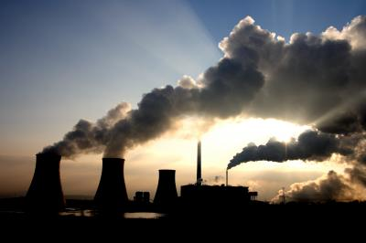
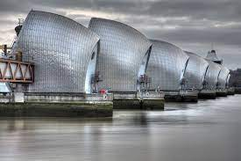
Why do we need climate projections?
Mitigation
Adaptation
Quantitative information about future climate for decision making

Slide 6
Knowledge of how the Earth system works
Earth System Models
IPCC synthesis
Future climate projections

Slide 7

What is the IPCC?
The Intergovernmental Panel on Climate Change (IPCC) is the United Nations body for assessing the science related to climate change.

Slide 8

The IPCC is not the same as the COP
Synthesis of scientific evidence
Meeting of decision makers

Slide 9
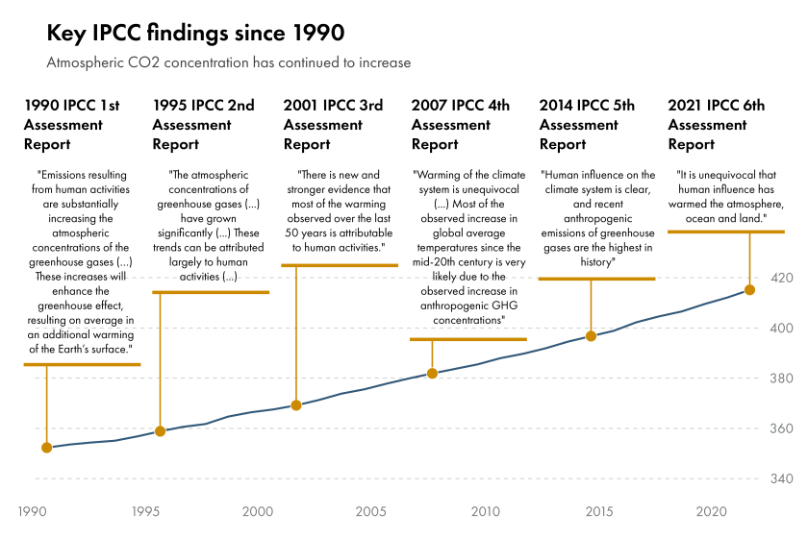
History of the IPCC

Slide 10
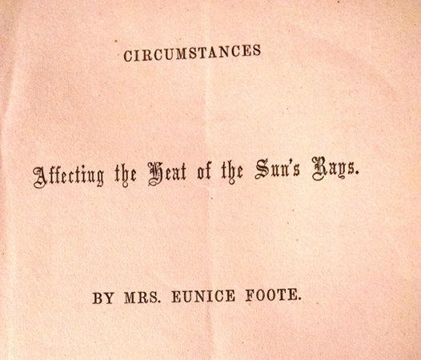
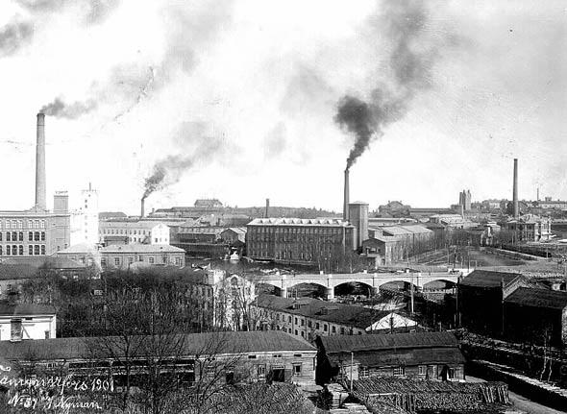
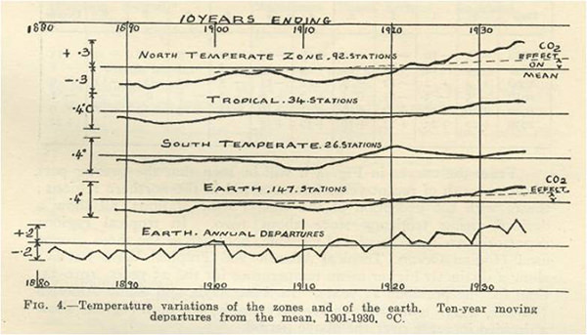
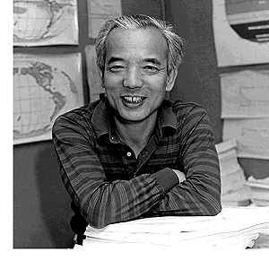
The history of climate change science
1856 Discovering gases that trap heat
1960s First predictive models of the atmosphere
1896 Connecting coal, CO₂ and climate
1936 Connecting temperature to CO₂
https://scied.ucar.edu/learning-zone/how-climate-works/history-climate-science-research

Slide 11

Why do we need the IPCC?
The IPCC synthesises scientific knowledge in a way that is consistent and accessible to policy makers

Slide 12
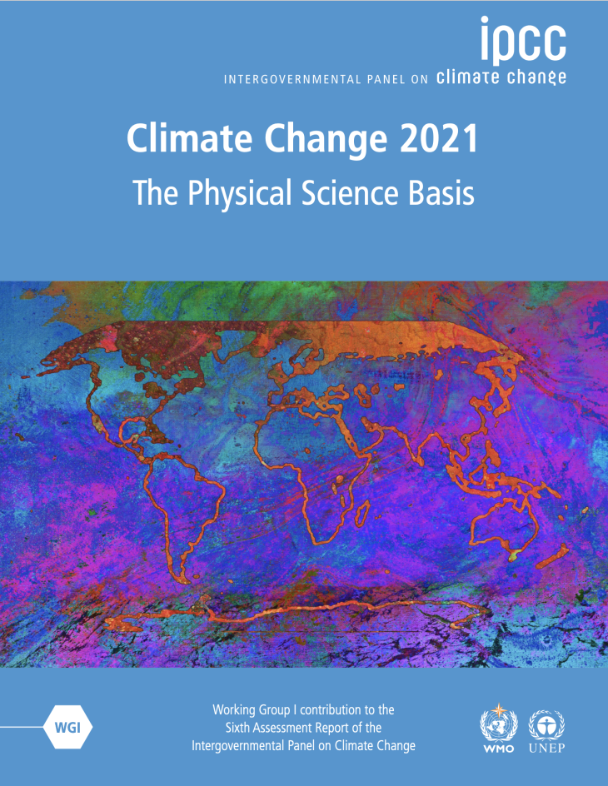


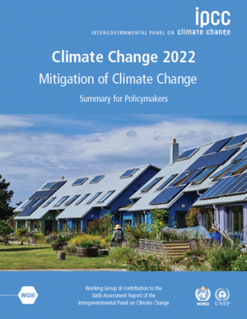
IPCC process
Scientists
198 lead authors
Review
78,007 written review comments were submitted by 1891 individual expert reviewers and 47 governments
Assessment reports
Scientific evidence

Slide 13
Working group 1: physical science basis
The most up to date physical understanding of the climate system

Slide 14
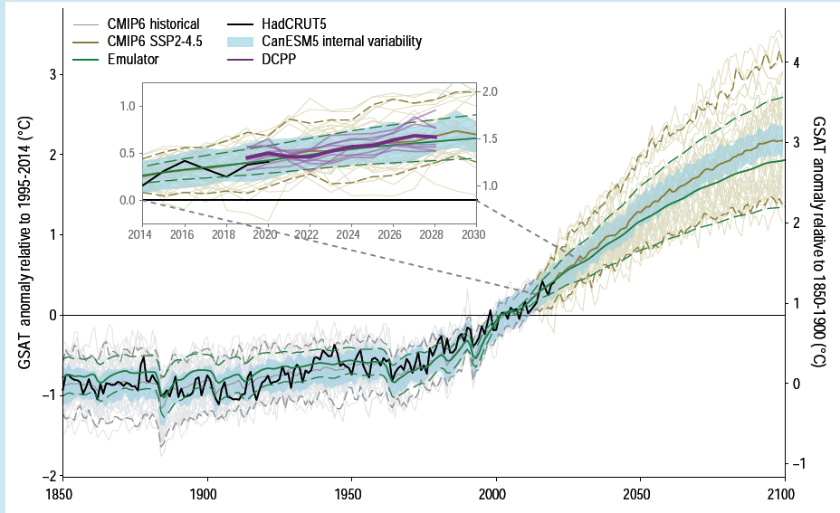
Working group 1: physical science basis

Slide 15
Working group 2: impacts, adaptation and vulnerability
The impacts of climate change on ecosystems, biodiversity, human communities and their capacity to adapt

Slide 16
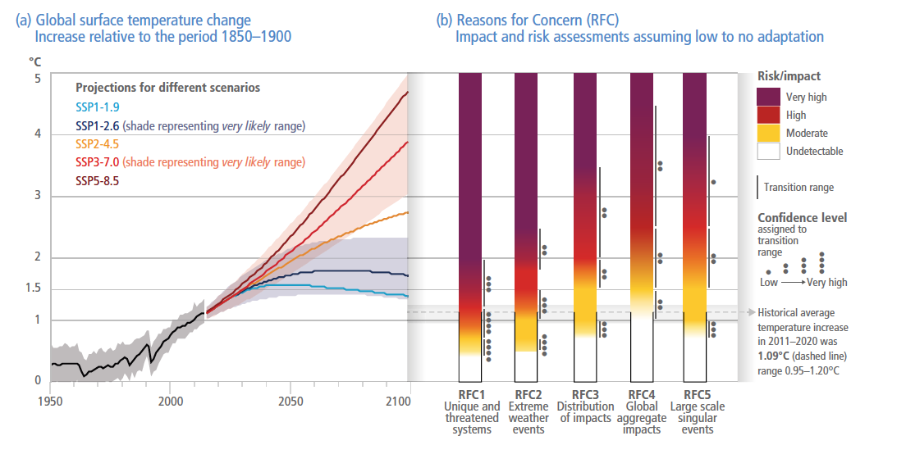
Working group 2: impacts, adaptation and vulnerability

Slide 17
Working group 3: mitigation of climate change
Current emission reduction pledges and their effect on the climate as well as future scenarios

Slide 18
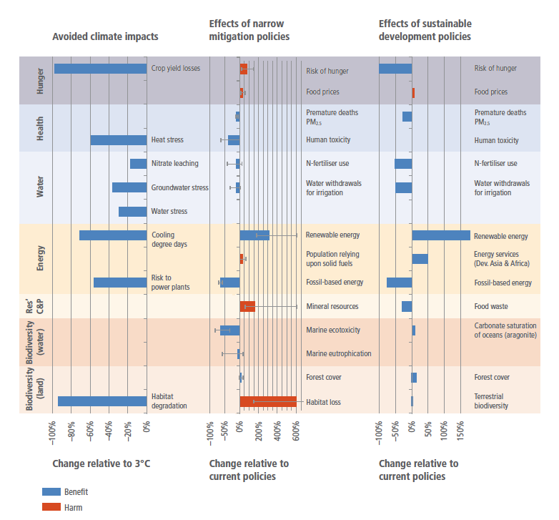
Working group 3: mitigation of climate change

Slide 19
IPCC Guidelines for National Greenhouse Gas Inventories
National inventory
UN global inventory
National inventory
National inventory
IPCC guidelines
Transparent
Accurate
Consistent
National inventory

Slide 20
Special reports
Global Warming of 1.5 ºC
Climate change and land
The ocean and cryosphere in a changing climate
Methodological reports

Slide 21
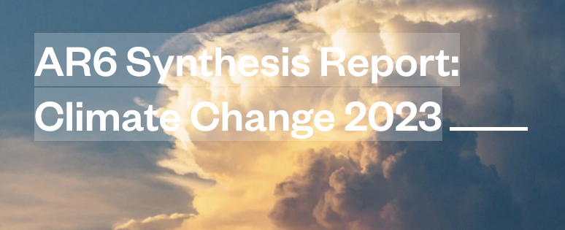
Anatomy of a report: synthesis report
Short (30 page) report synthesis the findings of all three working groups

Slide 22
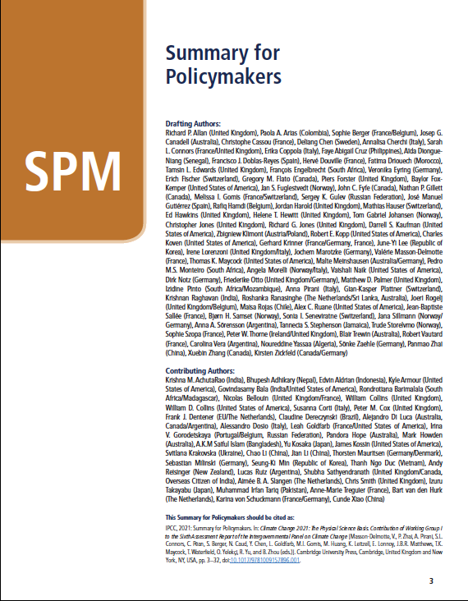
Anatomy of a report: summary for policy makers
Non-technical short summaries (30-50 pages)
Very careful language intended for use in decision making contexts

Slide 23
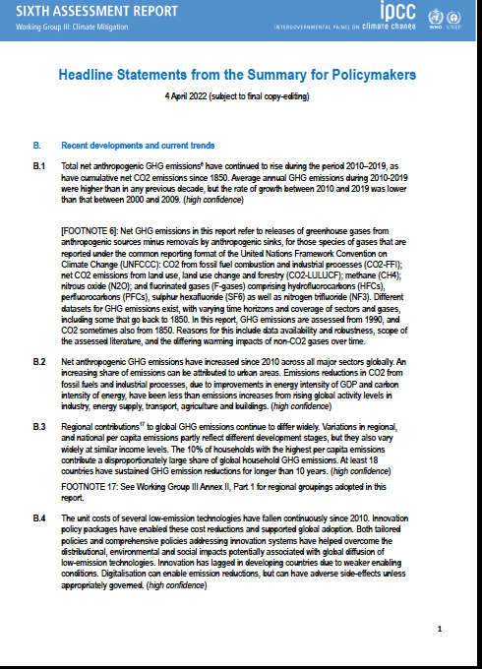
Anatomy of a report: summary for policy makers
Headline statements: clearly defined conclusions

Slide 24
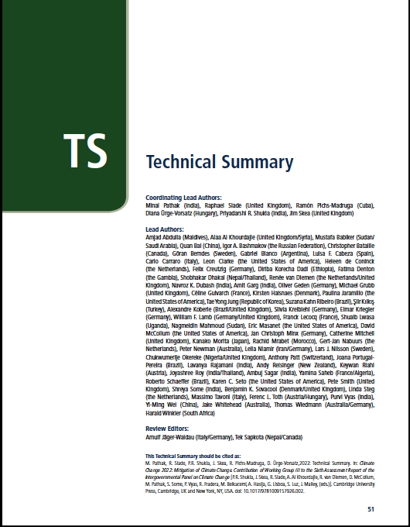
Anatomy of a report: technical summary
Summary for scientists, with more technical language and detailed figures (~100 pages)
If you read anything, read this

Slide 25
Anatomy of a report: the full report
Fully referenced, exhaustive scientific report
Extremely very long (over 2000 pages)

Slide 26
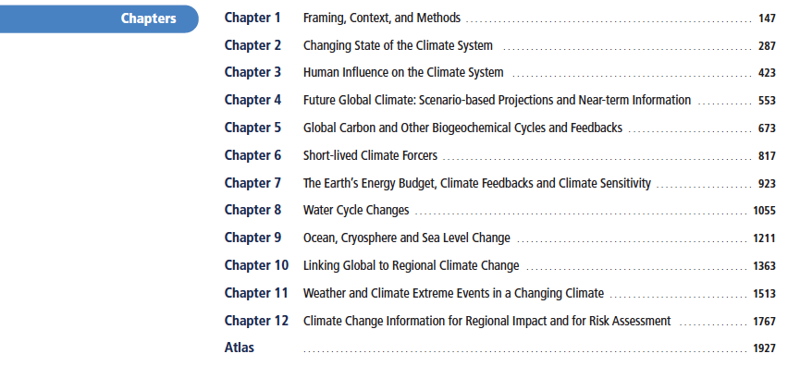
Anatomy of a report: the full report
Thematic chapters

Slide 27
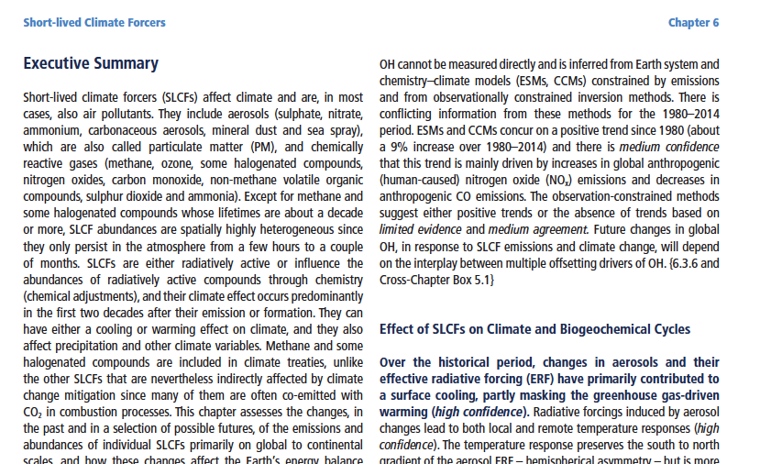
Anatomy of a report: the full report
Each individual chapter has an executive summary
These are needed because no one can read the full report

Slide 28
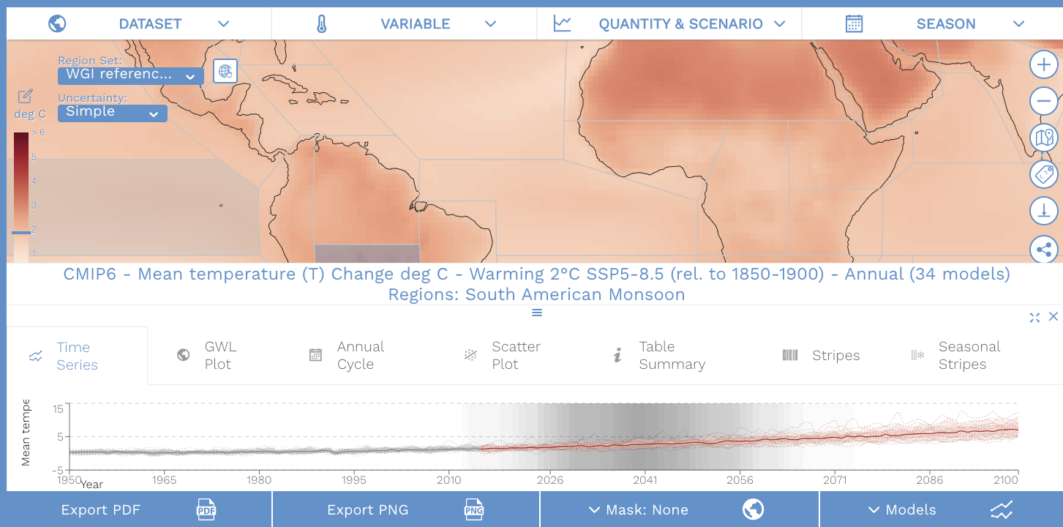
Website extras: WG1 interactive atlas
https://interactive-atlas.ipcc.ch/

Slide 29
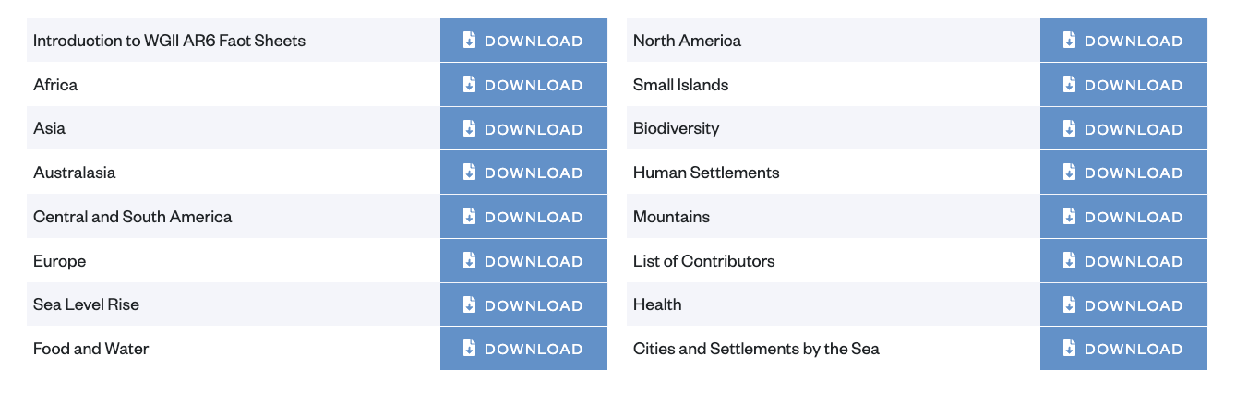
Website extras: fact sheets
https://interactive-atlas.ipcc.ch/

Slide 30
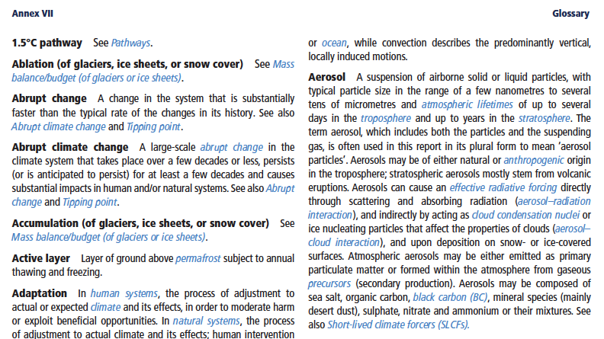
Precise language
Each working group report has a comprehensive glossary to ensure terms are used consistently
A good place to check if you want a quick and reliable definition

Slide 31
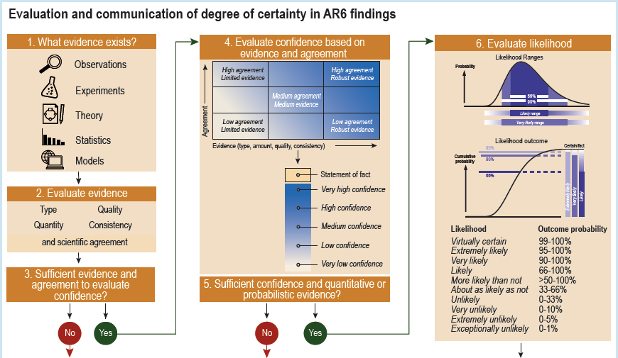

Slide 32
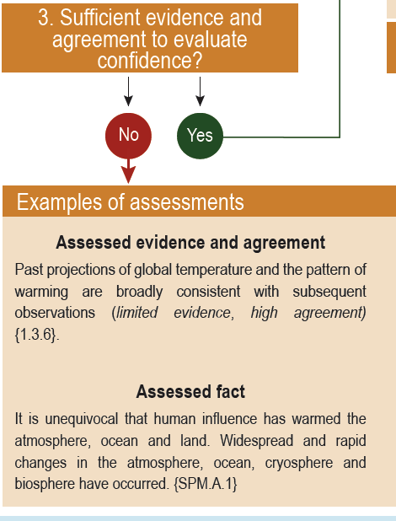
Not enough evidence to evaluate confidence

Slide 33
Calibrated language: evidence and agreement
Qualitative measure of confidence

Slide 34
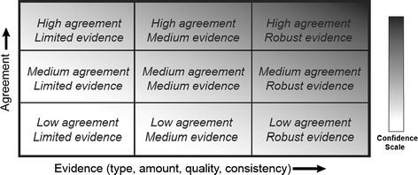
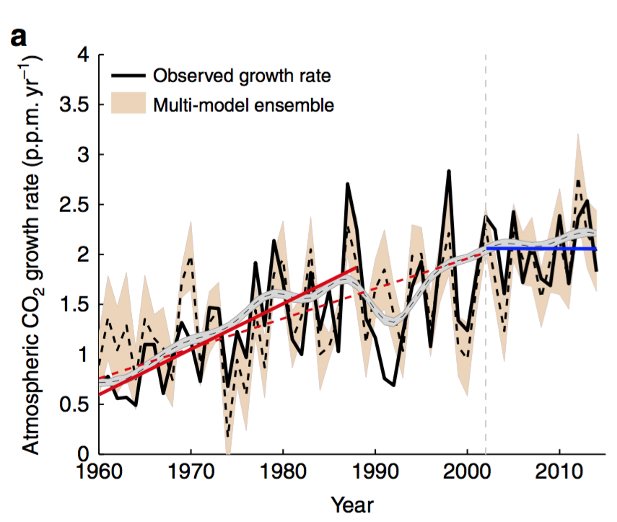
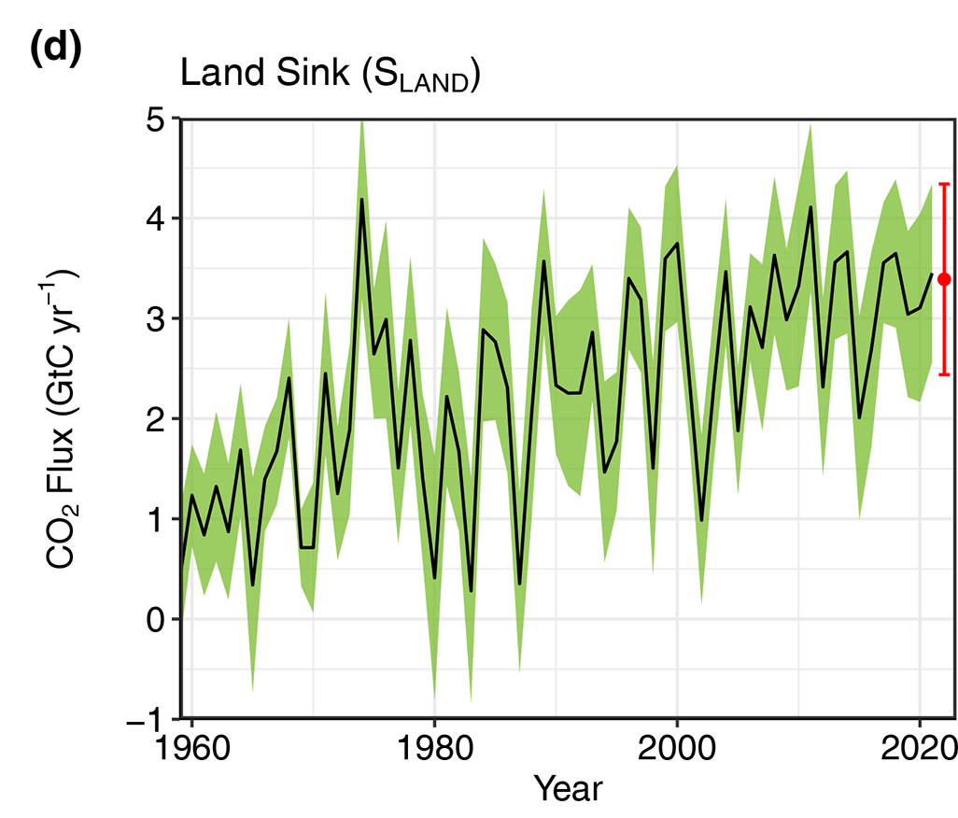
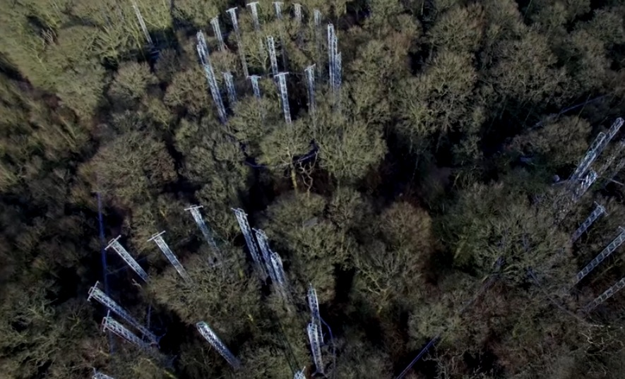
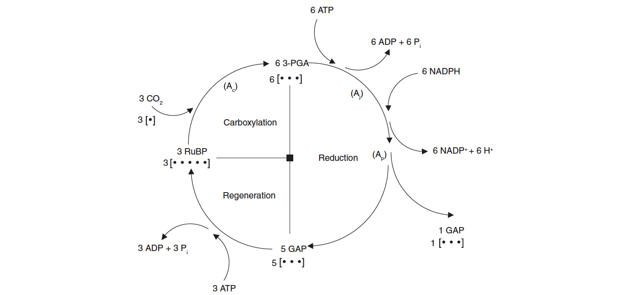
Calibrated language: evidence and agreement
Is the land carbon sink increasing with higher CO₂?
Measurements
Experiments
Theory
Predictive models
Robust evidence with medium to high agreement

Slide 35
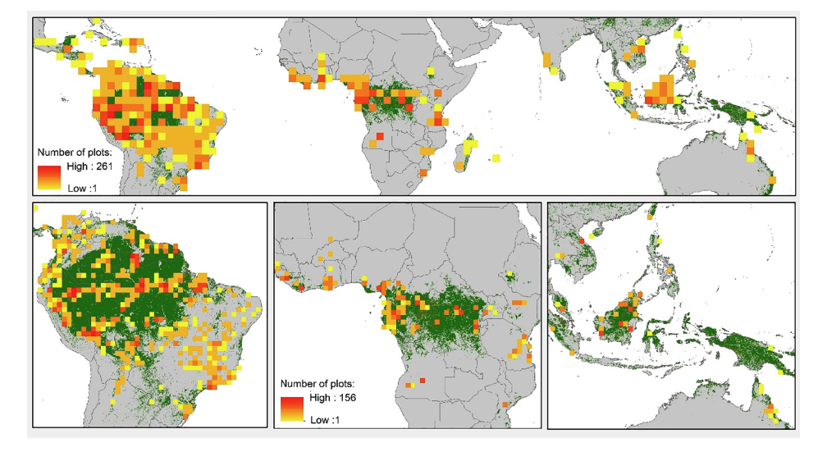
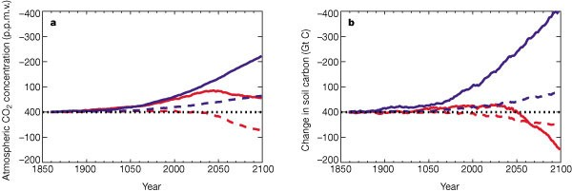
Calibrated language: evidence and agreement
Will there be an Amazon forest die back?
Measurements
Experiments
Theory
Predictive models
Limited evidence with low to medium agreement

Slide 36
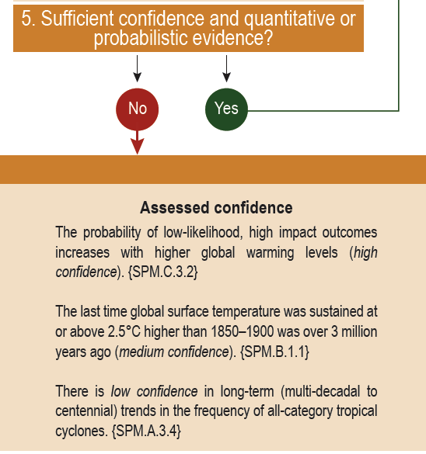
Not enough evidence to assess likelihood

Slide 37
Calibrated language: likelihood

Slide 38
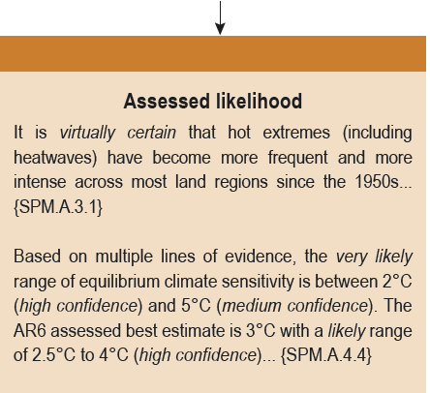

Slide 39
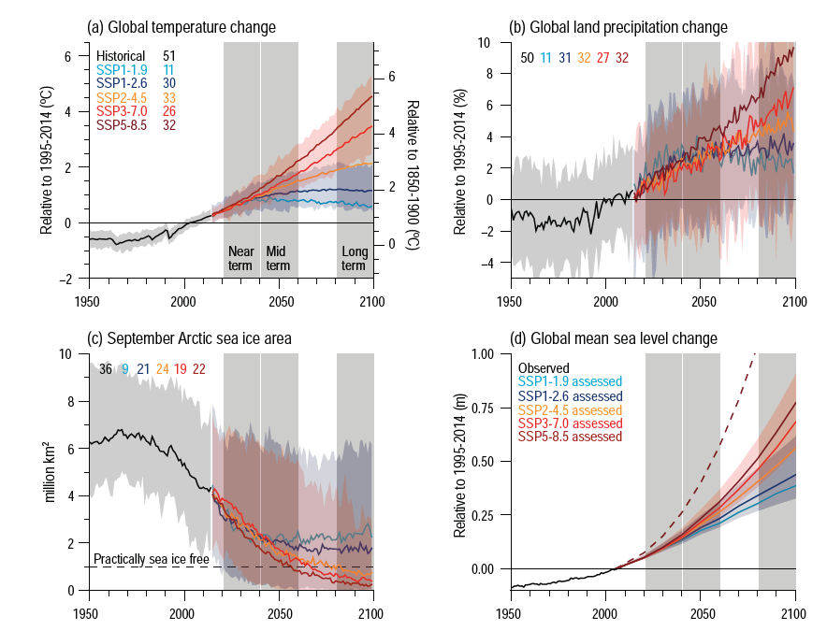
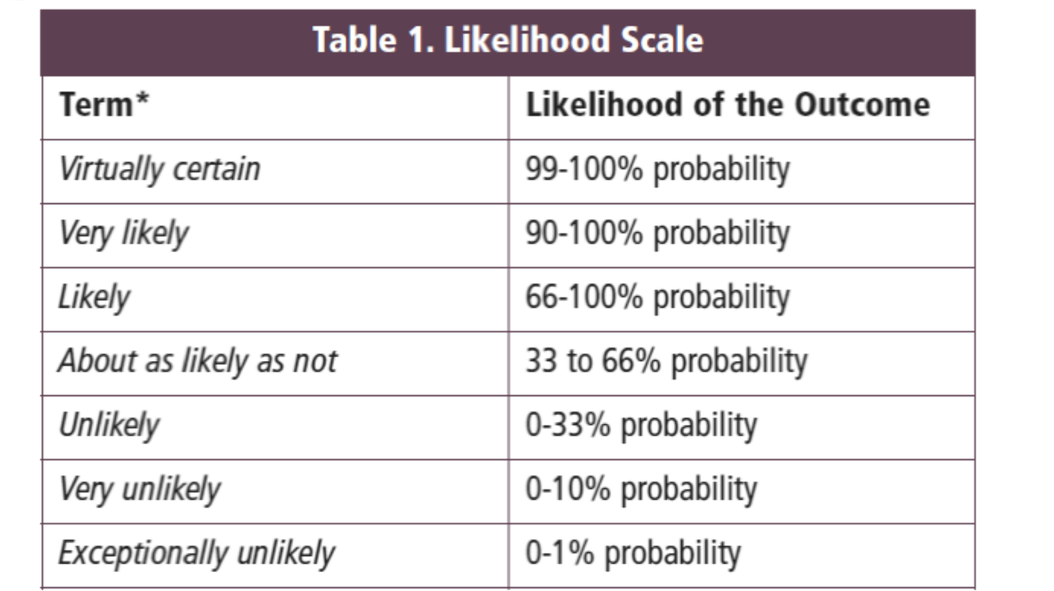
Calibrated language: likelihood
Predictions of future global temperature from different lines of evidence

Slide 40
What are these predictions? What is uncertainty?

Slide 41
Atmosphere
Climate fundamentals
Predicting climate
Atmosphere
Global C cycle
IPCC report
Earth system models
Climate impacts
Climate solutions
Extreme events
Tipping points
Sea ice, ice caps,
Energy
Mitigation
Nature-based solutions

